Slide 1


Maturing SDLC at a Fortune 500 Company based on OWASP SAMM: Successes and Pitfalls
Sunny Sharma - Zebra Technologies

Slide 2




The Challenge of Application Security
1
Customer Trust
2
Lack of Role Models
3
Tool-Related Challenges
Application security is paramount for software development.
Limited examples exist for effective application security implementation.
Security tools can sometimes exacerbate existing problems.

Slide 3




A Risk-Driven and Measurable Approach
The Need
The Challenge
The Solution
Security solutions should be risk-driven and measurable.
Finding a suitable AppSec program with these characteristics is difficult.
OWASP SAMM offers a clear, concise, and measurable framework.

Slide 4






Quiz Time!
Test your understanding of Zebra Technologies' SAMM journey.

Slide 5
Question 1
What was the primary driver for Zebra Technologies to adopt a risk-driven and measurable approach to application security?
A) Customer Trust
B) Lack of role models
C) Tool-related challenges
D) All of the above

Slide 6
Question 1
What was the primary driver for Zebra Technologies to adopt a risk-driven and measurable approach to application security?
A) Customer Trust
B) Lack of role models
C) Tool-related challenges
D) All of the above

Slide 7
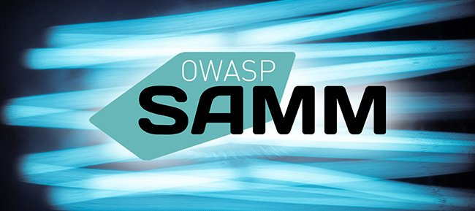
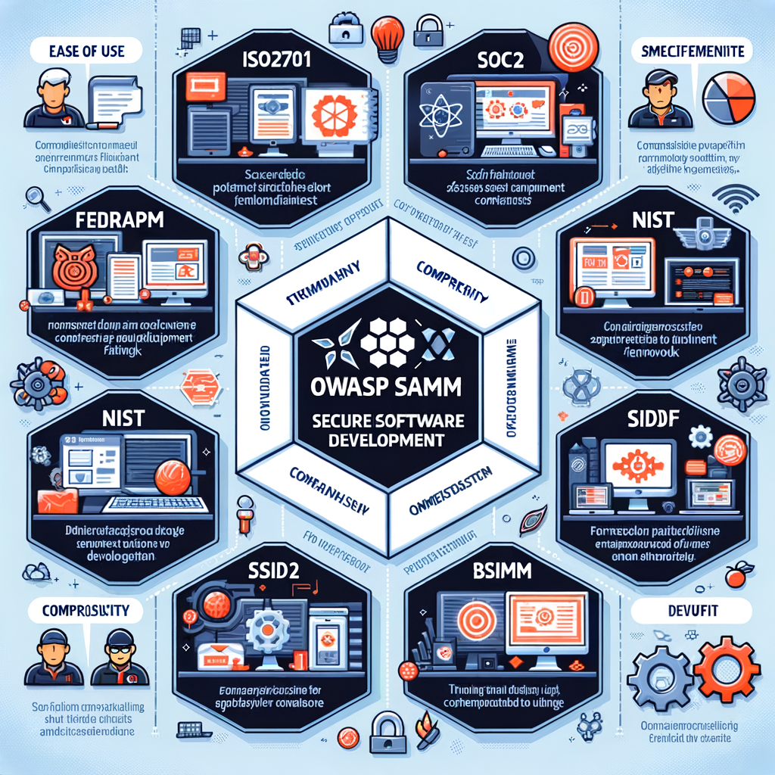
Why OWASP SAMM?
Framework
Measurability
Clarity
ISO27001, FedRamp, SOC2
No
-
NIST SSDF
Vague
-
BSIMM
Yes, but complex
Privately owned, hard to comprehend
OWASP SAMM
Yes
Clear, concise, easy to measure

Slide 8

Implementing SAMM at Zebra Technologies
1
2022
In 2022, we introduced the OWASP SAMM framework to systematically assess and improve our application security practices.
2
2022-2024
Over 3 years, we've seen significant security improvements by implementing SAMM to identify gaps, streamline processes, and empower teams.
3
2024
Today, we're excited to share our SAMM implementation journey, including challenges, solutions, and benefits of this transformative initiative.

Slide 9

Defining SAMM Scopes
Scope Selection
Simultaneous Implementation
Business units (BUs) were chosen as scopes for assessment and improvement.
SAMM was introduced across all BUs concurrently.
Regular Monitoring
SAMM became a standing agenda item in weekly security forums with BU leads.

Slide 10

Initial Challenges and Solutions
1
Skepticism
2
Interpretation Difficulties
Some BU leads questioned SAMM's uniqueness.
Understanding SAMM activities and criteria was challenging, especially for embedded and delivered software teams.
3
Cross-Functional Alignment
Addressing governance and operations, which transcended BU boundaries, required a coordinated approach.

Slide 11



Benefits of Open Communication
Common Language
Buy-In
Increased Awareness
Discussions fostered a shared understanding of SAMM's objectives.
Open dialogue secured buy-in from different teams.
Discussions on strategy, metrics, risk, and training raised awareness.

Slide 12
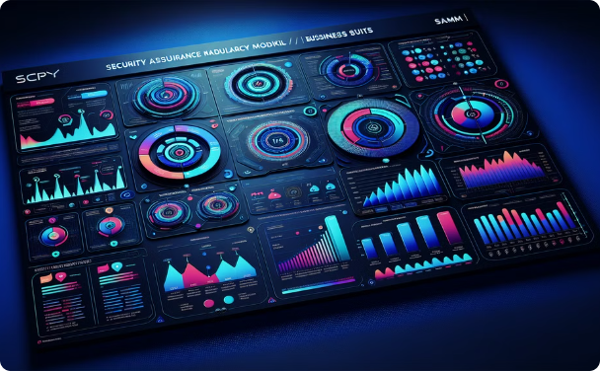

Public Display
Friendly Competition
Publishing SAMM scores on a corporate dashboard increased awareness.
Dashboards sparked unofficial competition among BUs to achieve higher scores.
The Gamification Effect

Slide 13

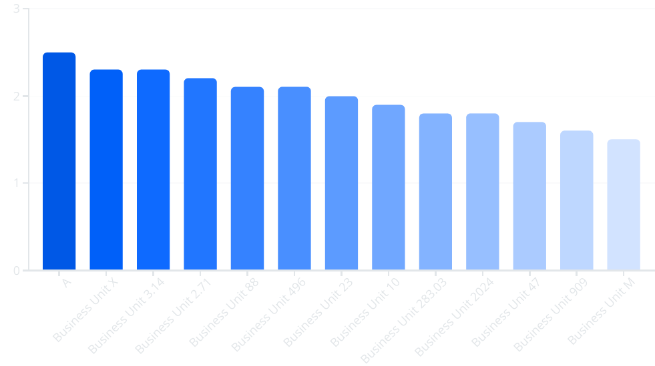
Prioritizing Security Initiatives Across Business Units
Everyone wants to be NUMBER ONE! But with this comes some concerns ……

Slide 14



Addressing Gamification Concerns
Addressing Control Weights: Shift in Focus
Potential Drawback
External Validation
Focusing solely on scores could divert resources from risk-based improvements.
Zebra transitioned from absolute SAMM scores to a "percentage to target" metric.
External SAMM practitioners were engaged to ensure score objectivity.

Slide 15

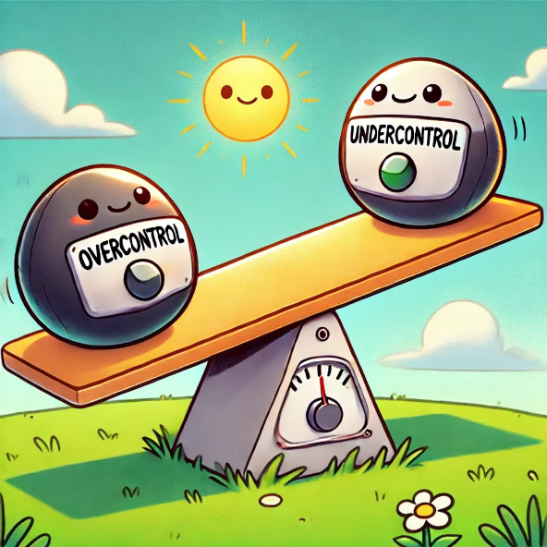


Overall Performance
1
2
3
1
UNDER CONTROL
2
AVERAGE
3
OVERCONTROL

Slide 16



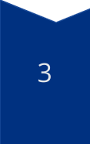
Establishing Corporate Benchmarking
Initial Approach
Minimum SAMM score per activity for each BU.
Challenge
Teams aimed for an average score of 3, which is not always practical or recommended.
Refined Approach
Focus shifted to the gap between current scores and the minimum set by the corporate SDLC policy.

Slide 17

Refining the "Percentage to Target" Metric
The metric was refined to calculate the average percentage of the gap per SAMM question, preventing bonus points for overachieving and promoting risk-based prioritization.

Slide 18
Quiz Time!
Test your understanding of Zebra Technologies' SAMM journey.

Slide 19
Question 2
What key metric did Zebra Technologies use to address the potential drawbacks of gamification in SAMM implementation?
A) Absolute SAMM score
B) Percentage to target
C) Risk score from ASPM tool
D) Number of security vulnerabilities

Slide 20
Question 2
What key metric did Zebra Technologies use to address the potential drawbacks of gamification in SAMM implementation?
A) Absolute SAMM score
B) Percentage to target
C) Risk score from ASPM tool
D) Number of security vulnerabilities

Slide 21
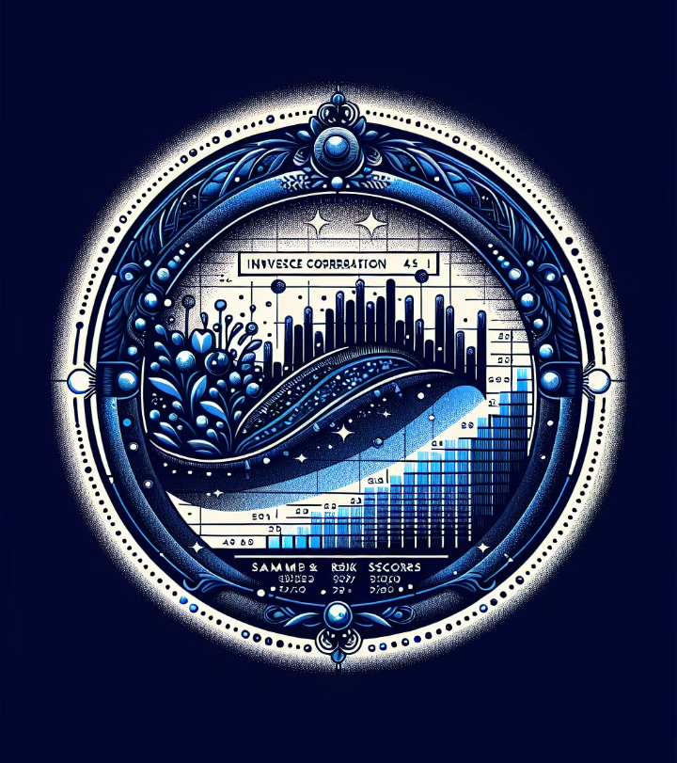




Correlating SAMM with Risk and Other Metrics
Analysis revealed a consistent inverse correlation between SAMM scores and risk scores from an Application Security Posture Management (ASPM) tool.

Slide 22

Key Findings
1
Inverse Correlation
2
SAMM and SDLC Maturity
Higher SAMM scores linked to lower risk scores in the ASPM tool.
SAMM-driven approach likely improves SDLC quality attributes.
3
Predictive Value
SAMM scores could potentially predict general SDLC maturity.

Slide 23
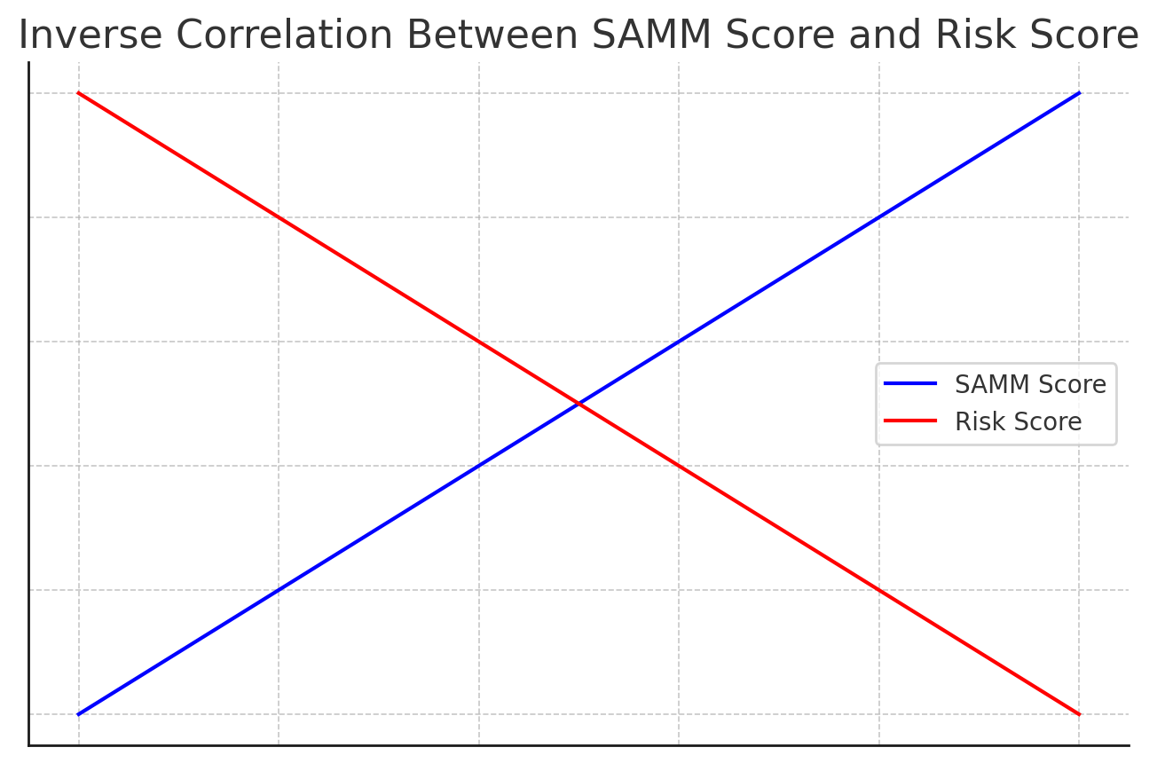
Inverse Correlation

Slide 24

Conclusion: SAMM's Impact at Zebra Technologies
OWASP SAMM has provided Zebra Technologies with a measurable approach to application security, raising awareness and driving improvements across various metrics.

Slide 25

One more thing…
Acquisitions

Slide 26
Quiz Time!
Test your understanding of Zebra Technologies' SAMM journey.

Slide 27
Question 3
What significant correlation did Zebra Technologies discover through their analysis of SAMM scores?
A) Higher SAMM scores correlate with increased development time
B) Higher SAMM scores correlate with lower risk scores in their ASPM tool
C) SAMM scores have no correlation with other security metrics
D) Lower SAMM scores indicate better adherence to industry standards

Slide 28
Question 3
What significant correlation did Zebra Technologies discover through their analysis of SAMM scores?
A) Higher SAMM scores correlate with increased development time
B) Higher SAMM scores correlate with lower risk scores in their ASPM tool
C) SAMM scores have no correlation with other security metrics
D) Lower SAMM scores indicate better adherence to industry standards

Slide 29

How much did this all cost?

Slide 30
Thank You!
We hope our experience with OWASP SAMM inspires your own application security journey.

